Slide 1
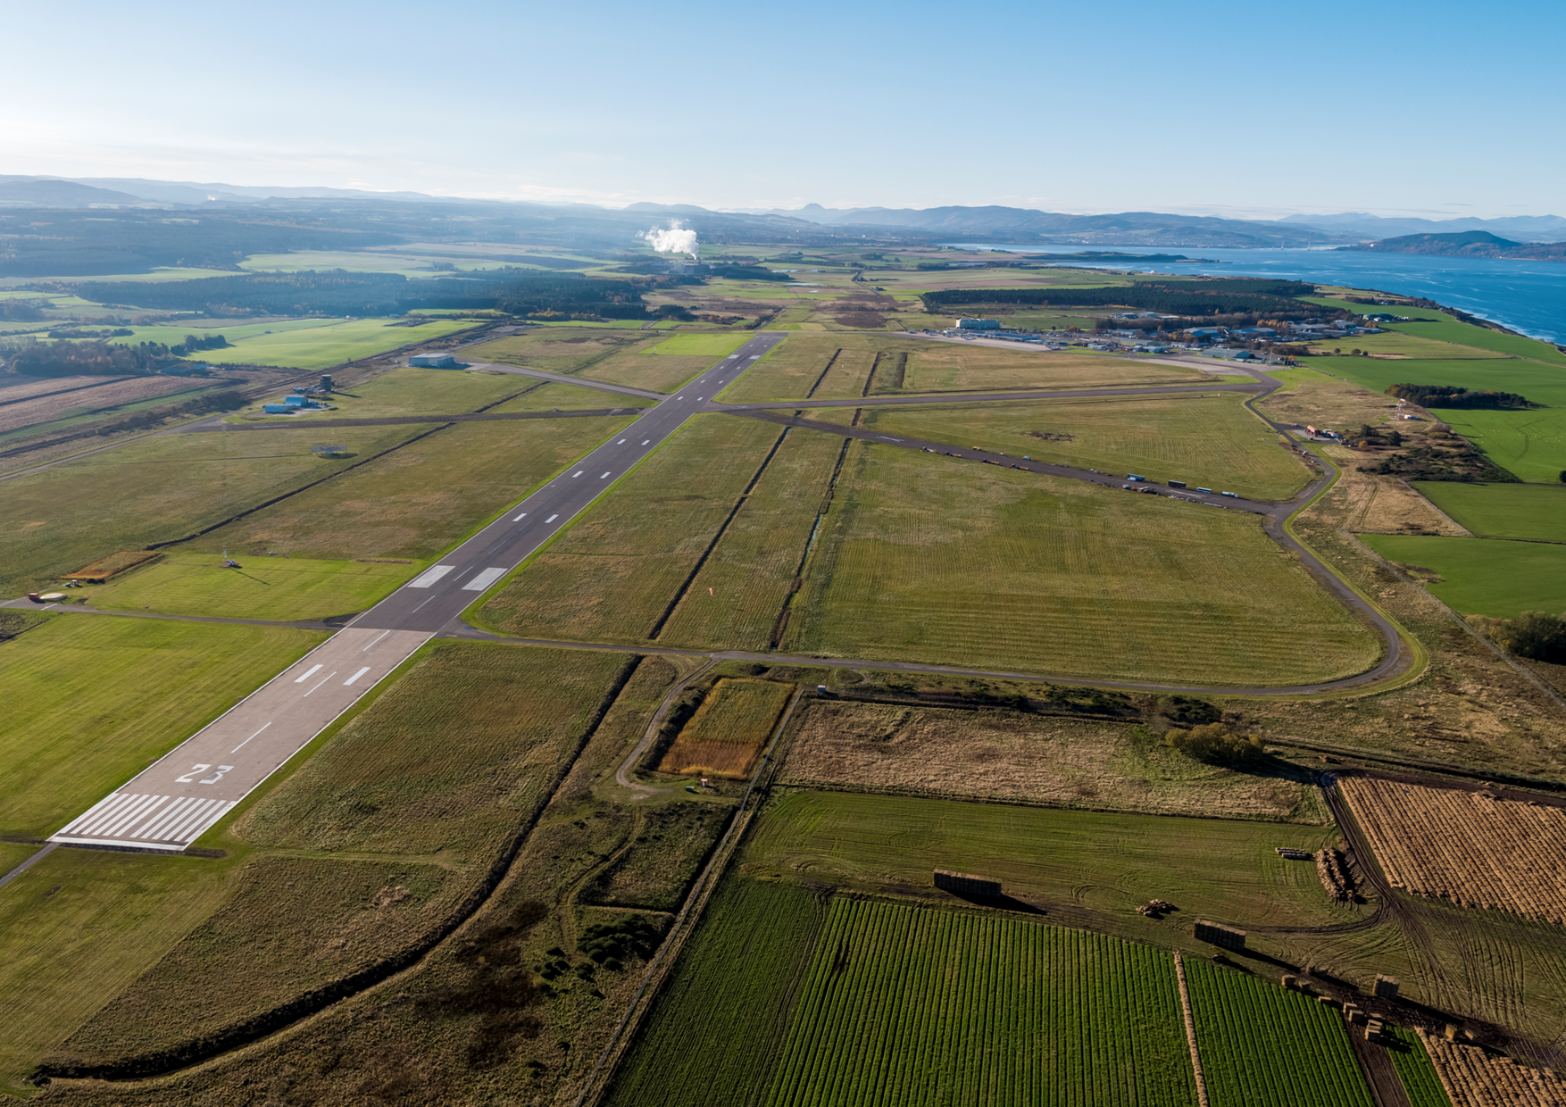


Inverness Airport
Carbon Footprint 2024
Report for Highland and Islands Airports Limited (HIAL)
November 2024

Slide 2
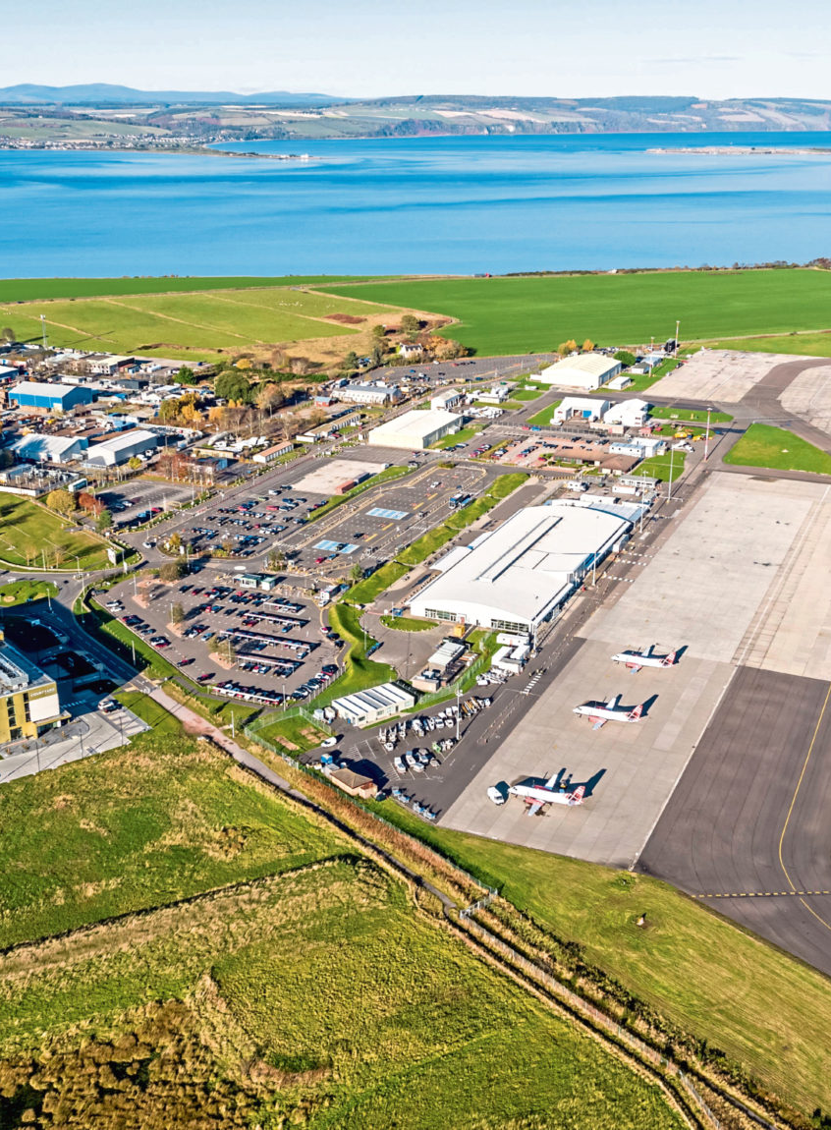
Contents
Contents
Introduction | 3
Methodology overview | 4
Inverness Airport 2024 Footprint: Summary By emissions source Scope 1 emissions Scope 2 emissions Scope 3 emissions | 5
Inverness Airport 2024 Footprint: market-based | 10
Inverness Airport annual emissions trends | 11
Annex 1 - Methodology | 14

Slide 3
Introduction
This is the 2024 Annual Carbon Footprint Report for Inverness Airport. Inverness Airport is operated by Highlands and Islands Ltd (HIAL), a public corporation owned by the Scottish Ministers and subsidised by the Scottish Government. HIAL operates and manages 11 airports across northern Scotland - Barra, Benbecula, Campbeltown, Dundee, Inverness, Islay, Kirkwall, Stornoway, Sumburgh, Tiree and Wick.
This report has been prepared by Waterman Infrastructure & Environment Ltd (Waterman), in collaboration with HIAL staff. The report covers the operations of Inverness Airport for the 2024 financial year (1 April 2023 to 31 March 2024). During the reporting, period, Inverness Airport welcomed 792,150 passengers (an increase of 6% on the previous year), however aircraft movements have decreased by 4% (to 25,897).
This report identifies the estimated emissions associated with the operation of Inverness Airport (including HIAL Head Office and New Century House) for the 2024 financial year and trends over recent years, to help identify opportunities to target emissions reduction actions. As this is the first year that Waterman has completed HIAL's carbon footprint reporting, there have been some changes in methodologies compared to previous years. Recommendations to improve data quality for future reporting years have been communicated to HIAL.
Waterman would like to thank the staff at HIAL for their co-operation and input into this project and report.

Slide 4
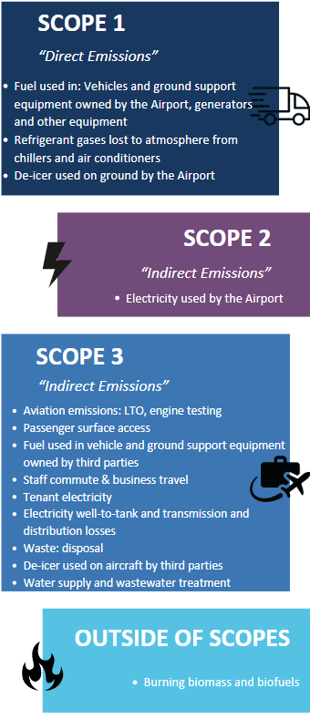
Methodology overview
All emissions have been calculated in line with the Greenhouse Gas (GHG) Protocol and ISO 14064-1, to ACA Level 3 Standard. Inverness Airport currently holds Level 1 ACA accreditation with aspirations to achieve higher levels of accreditation in future. While previous reports have included aspects of ACA Level 4 Standard, HIAL has decided to scale back reporting in 2024 to focus on improved data collection and accuracy for the foundation levels (1-3) of ACA accreditation. Therefore, some emissions sources previously reported, such as Climb, Cruise, Descent (CCD) emissions, are excluded from this report.
The emissions sources included are shown in the adjacent boxes. This report is primarily presented based on the location-based calculation methodology, with a market-based emissions profile towards the end of this report (further explanation on page 8). A detailed explanation of the methodology and assumptions can be found in Annex 1.

Slide 5
Inverness Airport 2024 Footprint - Summary
Location-Based emissions
Market-Based emissions
13,095 tonnes CO₂e
12,441 tonnes CO₂e

Slide 6
Inverness Airport 2024 Footprint – By emissions source
 | Emissions (tCO2e) | % of Scope | % of Total Emissions
Scope 1 – Total | 778 |  | 5.9%
Natural gas | 38 | 4.9% | 0.3%
Fuel (heating, power, GSE) | 715 | 91.8% | 5.5%
Refrigerants | 23 | 3.0% | 0.2%
Fire training | 2 | 0.3% | 0.0%
Scope 2 – Total | 654 |  | 5.0%
Airport electricity | 654 | 100.0% | 5.0%
Scope 3 - Total | 11,618 |  | 88.7%
Landing Take-off (LTO) | 8,547 | 73.6% | 65.3%
Passenger surface access | 1,994 | 17.2% | 15.2%
Tenant electricity | 118 | 1.0% | 0.9%
Electricity WTT | 186 | 1.6% | 1.4%
Electricity T&D | 68 | 0.6% | 0.5%
Fuels WTT | 178 | 1.5% | 1.4%
Waste | 1 | 0.0% | 0.0%
Staff commute | 327 | 2.8% | 2.5%
Third party de-icer | 71 | 0.6% | 0.5%
Aircraft engine tests | 11 | 0.1% | 0.1%
Water | 5 | 0.0% | 0.0%
Business travel | 112 | 1.0% | 0.9%
Out of Scopes – Total | 45 |  | 0.3%
Diesel | 44 | N/A | 0.34%
Petrol | 1 | N/A | 0.01%
Wood | 0 | N/A | 0.00%
Total | 13,095 |  | 100.0%

Slide 7
Inverness Airport 2024 Footprint – Scope 1
Scope 1 emissions are direct greenhouse gas emissions that occur from sources owned or controlled by HIAL. For Inverness Airport, the major emissions sources in this category are natural gas used for heating, fuels used for power, the operation of ground support equipment (GSE) and airport operational vehicles. Fuel burnt during fire training and use of refrigerant gases are also captured under Scope 1.
Scope 1 emissions have increased by 36% this year, mostly attributed to fuel use for heating, power, and GSE.
However, GSE emissions and tenant natural gas have been re-classified from Scope 3 to Scope 1 this year due to a lack of data, which accounts for the increase.
Total Scope 1 emissions – 778 tonnes CO₂e

Slide 8
Inverness Airport 2024 Footprint – Scope 2
Scope 2 emissions are those associated with the consumption of electricity at the airport. Electricity emissions are reported under 2 approaches:
Location-based: reflecting the average emissions intensity of electricity grids where energy consumption occurs. Under this approach, emissions are calculated used the National Grid average emission factor, sourced from the UK Government GHG Conversion factors for Company Reporting 2024.
Market-based: reflecting the emissions from HIAL’s purchasing arrangements for electricity and the fuel mix associated with their energy tariff. During the reporting period (1 April 2023 – 31 March 2024), all of HIAL’s purchased electricity was covered by renewable energy guarantees of origin (REGO) certificates. Therefore, electricity emissions are reported as zero carbon under the market-based methodology.
Location-Based electricity emissions (tCO₂e) Market-Based electricity emissions (tCO₂e)
654 0
Scope 2 emissions have continued to increase this year, which is partly due to a continued increase in passenger numbers post-Covid – passenger numbers have increased 6% this reporting year, though aircraft movements have reduced by 4%.
Some data challenges were identified and recommendations to improve data accuracy in future years have been identified.

Slide 9
Inverness Airport 2024 Footprint – Scope 3
Scope 3 emissions are indirect greenhouse gas emissions that arise as a consequence of the activities of HIAL, but occur from sources not owned or controlled by the company. For Inverness Airport, the major emission source in this category is from aircrafts’ aviation fuel. As an airport operator, HIAL reports on the emissions associated with aircraft movements around the airport, i.e. taxi-ing, take-off, landing and time spent on APU. Other sources in Scope 3 include passenger surface access, staff commute and business travel, waste, water and wastewater treatment and aircraft de-icing.
Total Scope 3 emissions - 11,618 tonnes CO₂e

Slide 10
Inverness Airport 2024 Footprint – Market based emissions
 | Emissions (tCO2e) | % of Scope | % of Total Emissions
Scope 1 – Total | 778 |  | 6.3%
Natural gas | 38 | 4.9% | 0.3%
Fuel (heating, power, GSE) | 715 | 91.8% | 5.7%
Business travel | 0 | 0.0% | 0.0%
Refrigerants | 23 | 3.0% | 0.2%
Airport de-icer | 0 | 0.0% | 0.0%
Fire training | 2 | 0.3% | 0.0%
Scope 2 – Total | 0 |  | 0%
Airport electricity | 0 | 100.0% | 0%
Scope 3 - Total | 11,618 |  | 93.4%
Landing Take-off (LTO) | 8,547 | 73.6% | 68.7%
Passenger surface access | 1,994 | 17.2% | 16%
Tenant electricity | 118 | 1.0% | 1.0%
Tenant natural gas | 0 | 0.0% | 0.0%
Electricity WTT | 186 | 1.6% | 1.5%
Electricity T&D | 68 | 0.6% | 0.5%
Fuels WTT | 178 | 1.5% | 1.4%
Waste | 1 | 0.0% | 0.0%
Staff commute | 327 | 2.8% | 2.6%
Third party de-icer | 71 | 0.6% | 0.6%
Aircraft engine tests | 11 | 0.1% | 0.1%
Water | 5 | 0.0% | 0.0%
Business travel | 112 | 1.0% | 0.9%
Out of Scopes – Total | 45 |  | 0.4%
Diesel | 44 | N/A | 0.4%
Petrol | 1 | N/A | 0.0%
Wood | 0 | N/A | 0.0%
Total | 12,441 |  | 100%

Slide 11
Inverness Airport annual emissions trends (tonnes CO₂e)
 | 2020 | 2021 | 2022 | 2023 | 2024
Scope 1 – Total | 756 | 846 | 1,116 | 572 | 779
Natural gas | 0 | 0 | 0 | 13 | 38
Fuel (heating, power, GSE) | 725 | 804 | 1,114 | 548 | 715
Business travel | 11 | 19 | 1 | 2 | 0
Refrigerants | 16 | 17 | 0 | 0 | 23
Airport de-icer | 0 | 0 | 0 | 0 | 0
Fire training | 4 | 6 | 1 | 9 | 2
Scope 2 – Total | 755 | 605 | 583 | 400 | 654
Airport electricity | 755 | 605 | 583 | 400 | 654
Scope 3 - Total | 33,367 | 7,989 | 12,453 | 17,140 | 11,619
Landing Take-off (LTO) | 11,683 | 5,446 | 10,458 | 14,138 | 8,547
Passenger surface access | 15,649* | 1,986 | 1,228 | 1,888 | 1,994
Tenant electricity | 0 | 0 | 0 | 0 | 118
Tenant natural gas | 0 | 0 | 0 | 296 | 0
Electricity WTT | 124 | 95 | 180 | 141 | 186
Electricity T&D | 70 | 52 | 56 | 50 | 68
Fuels WTT | 0 | 0 | 0 | 0 | 178**
Waste | 370 | 17 | 74 | 32 | 1
Staff commute | 5,289 | 333 | 352 | 352 | 327
Third party de-icer | 48 | 13 | 27 | 60 | 71
Aircraft engine tests | 14 | 2 | 11 | 5 | 11
Water | 1 | 19 | 31 | 52 | 5
Business travel | 119 | 26 | 36 | 126 | 112
Out of Scopes – Total | 6 | 3 | 24 | 36 | 45
Diesel | 4 | 2 | 22 | 33 | 44
Petrol | 0 | 1 | 1 | 0 | 1
Wood | 2 | 0 | 1 | 2 | 0
Total | 34,884 | 9,443 | 14,176 | 18,148 | 13,097
*Passenger numbers in 2020 suspected to be over-reported due to a data error. ** Fuels WTT reported for the first time this year.

Slide 12
Inverness Airport annual emissions trends (% year on year changes)
 | 2020 | 2021 | 2022 | 2023 | 2024
Scope 1 | 25% | 12% | 32% | 49% | 36%
Scope 2 | 4% | 20% | 4% | 31% | 63%
Scope 3 | 33582% | 78% | 132% | 42% | 33%
Outside of scopes | 132% | 60% | 865% | 46% | 26%
Total | 2470% | 76% | 127% | 39% | 29%

Slide 13
Inverness Airport annual emissions trends (electricity and emissions)
Includes both airport (Scope 2) and tenant (Scope 3) electricity use. All emission figures exclude emissions from transmission and distribution (T&D) losses.

Slide 14
Annex 1 - Methodology
Emissions have been calculated in accordance with the Greenhouse Gas (GHG) Protocol Corporate Accounting and Reporting Standard, and ISO 14064-1 to ACA Level 3 Standard.
All activity data for the emissions calculations was provided by HIAL staff from sources including monthly supplier invoices, internal environmental performance monitoring and financial reporting data. Waterman undertook independent quality assurance of all activity data and clarified discrepancies or unusual trends with HIAL. For some sources, activity data was not available therefore assumptions and estimates were used to determine activity values. These are explained further for each source below. Emissions were then calculated using the UK Government Greenhouse gas reporting: conversion factors 2024.
Emissions are classified in the following scopes:
SCOPE 1: Direct GHG emissions arising from sources that are owned or controlled by HIAL, where HIAL has direct influence through its actions. Emissions sources included are: natural gas use, company owned vehicles fuel use, refrigerant gas use (from leaks during maintenance or malfunction), and fuel use for fire training.
SCOPE 2: Emissions associated with the use of electricity from a third-party supplier of energy in the form of heat or electricity. HIAL can influence the amount of electricity it uses; however, it has little control over the generation of the electricity and these emissions are therefore classed as Scope 2.

Slide 15
Annex 1 - Methodology
SCOPE 3: Emissions arising as an indirect consequence of the use of goods or services provided by HIAL. The airport does have some influence over Scope 3 emissions but the activities are not under its control. Sources included by the airport include aircraft (taxi, take-off, landing, auxiliary power usage), employees commuting to the airport, passenger surface access to the airport, airside vehicle activities by third party operators, waste disposal, water (supply and treatment), tenant electricity use, losses associated with the transmission and distribution of electricity, airport staff business travel, engine testing and aircraft de-icing by third party operators.
OUTSIDE OF SCOPES: Includes biogenic CO₂ factors that account for the direct carbon dioxide (CO₂) impact of burning biomass and biofuels. For HIAL this includes biogenic content of petrol, diesel and wood pallets combusted for fire training.
The approach to calculate or estimate emissions for each activity source is set out below. All emissions factors are sourced from the UK Government Greenhouse gas reporting: conversion factors 2024 unless stated otherwise.
SCOPE 1
Natural gas: Monthly kWh consumed at New Century House were sourced from supplier reports. Premises are unoccupied therefore consumption is low. Multiplied by emissions factor to calculate tonnes CO₂e.
Fuel: Monthly litres of fuel consumed were taken from supplier reports and fuel card data. Multiplied by emissions factor for each fuel type to calculate tonnes CO₂e.
Refrigerants: Kilograms of any f-gases lost through leaks or top ups of equipment were identified from third party service sheets. Multiplied by emissions factor for each gas type to calculate tonnes CO₂e.
Fire training: Kilograms and litres of fuel used for fire training were taken from monthly HIAL records. Multiplied by emissions factor for each fuel type to calculate tonnes CO₂e.

Slide 16
Annex 1 - Methodology
SCOPE 2:
Airport electricity: Total kWh consumed was sourced from supplier reports. This was validated against HIAL monthly environmental performance monitoring data. HIAL data was found to be slightly lower, therefore the higher (more conservative) supplier total was used. Multiplied by emissions factor for each fuel type to calculate tonnes CO₂e. Emissions associated with electricity used by tenants within the airport is reported under Scope 3.
SCOPE 3:
Landing Take-Off (LTO): Emissions from aircraft taxi, take-off and landing were calculated using the ACI Airport Carbon and Emissions Reporting Tool (ACERT) version 7.2338. Aircraft movement data was provided by HIAL, capturing every aircraft arrival and departure at Inverness Airport during the reporting period. Each flight movement was categorised by the relevant Aircraft Type in the ACERT tool, and the total number of movements of each aircraft type was inputted to the tool. Average taxi in and out time was estimated in co-ordination with HIAL staff and is assumed to be an average of 10 minutes (in + out). Time spent on APU (auxiliary power unit) was also estimated in co-ordination with HIAL staff and is assumed to be an average of 60 minutes (per LTO cycle). Total tonnes CO₂e for all LTOs were calculated by the ACERT tool.
Passenger surface access: An updated survey of passenger movements has not been completed since the previous carbon footprint report. Emissions from passenger surface access were therefore estimated by applying an uplift of 3% to total passenger access emissions from the previous reporting year, in line with a 3% uplift in passenger numbers this year.
Tenant electricity: kWh consumed by tenants within the airport was calculated from HIAL meter reading data. Multiplied by emissions factor to calculate tonnes CO₂e.

Slide 17
Annex 1 - Methodology
Electricity WTT, T&D, Fuels WTT: Consumption totals were taken from the Scope 1 (fuels) and Scope 2 (electricity) categories, multiplied by emissions factor for WTT and T&D to calculate tonnes CO₂e.
Waste disposal: Kilograms of each category of waste disposed were taken from supplier reports and converted to tonnes. For hazardous waste, HIAL internal records of the number of bins, volume and frequency of collection were used to determine the total m³ of hazardous waste disposed of. All bins were assumed to be full when emptied therefore quantities are likely to be significantly over-reported. Volume (m³) was converted to weight (tonnes) using conversion factors from Draft 16 UK Waste Classification Scheme (DEFRA). Multiplied by emissions factor for each waste type to calculate tonnes CO₂e.
Staff commute: An updated survey of staff commuting has not been completed since the previous carbon footprint report. Emissions from staff commuting were therefore estimated by applying a downturn of 8% to total staff commute emissions from the previous reporting year, in line with a downturn in staff (FTE) at Inverness of 8% at the end of this reporting year.
De-icer: Total litres of de-icer used by third parties at the airport were taken from HIAL records of daily usage. Emissions factor for undiluted glycol was taken from the ACERT tool. Multiplied by emissions factor to calculate tonnes CO₂e.
Aircraft engine tests: The actual number of aircraft engine tests is not recorded therefore this was estimated by airport staff. Number of tests and fuel used was estimated to be consistent with previous years. Assumed fuel usage multiplied by emissions factor to calculate tonnes CO₂e.

Slide 18
Annex 1 - Methodology
SCOPE 3:
Water use and treatment: Total volume (m³) of water consumption was taken from supplier reports. This was validated against HIAL monthly environmental performance monitoring data. HIAL data was found to be higher therefore this more conservative figure was used, however consumption based on the source data was significantly lower than previous reporting years. The supplier was unable to provide updated data, therefore water consumption is likely to be significantly under-reported in this reporting year. The volume for wastewater treatment was calculated as 95% of total consumption. Multiplied by emissions factor to calculate tonnes CO₂e.
Business travel: Emissions from business travel activities were calculated based on business expenses spend data at group level and apportioned to Inverness based on FTE share. For fuel purchases where fuel type was not known, it is assumed 50% of spend is petrol and 50% is diesel. As only aggregated data on rail and ferry expenses was available, HIAL have determined a split of two-thirds rail and one-third ferry. The Sustainable Scotland Network Carbon Footprint and Project Register (CFPR) tool was used to determine costs per unit of distance travelled for the five categories of public transport (air, ferry, rail, bus and taxi). Activity data was multiplied by emissions factor to calculate tonnes CO₂e for each business travel type. Total emissions from each travel type were then multiplied by 0.39, reflecting 39% of HIAL staff located at Inverness Airport. Therefore, total emissions for business travel are indicative only.
OUTSIDE OF SCOPES:
Petrol, diesel, wood: Consumption totals taken from Scope 1 (fuel use and fire training) and multiplied by biogenic emissions factors to calculate tonnes CO₂e

